Slide 1
Library Management System
Capstone Project review -2
BATCH NUMBER:17
Presented by:
25B11AI401- HARIJANA VAMSI
25B11AI905- PASUMARTHI SURYA VAMSI
25B21AIC24 - UNNAM NAGARJUNA
25B21AI054 - ARABOLU RAMBABU
Academic Year: 2026-2027
Under esteemed guidance of
Dr P Kishorekumar
Associate Professor
Department of AIML
Aditya University

Slide 2
1. Project Overview
The Library Management System is a centralized relational database designed to manage library information efficiently.
It maintains information about books, authors, categories, publishers, members, librarians, suppliers, issue records, fines, and reservations.
The system connects these entities through Primary Keys and Foreign Keys.
It supports efficient management of book availability, issue and return transactions, reservations, and fine records.
The database design helps reduce data duplication, maintain data integrity, and enable efficient SQL-based retrieval.

Slide 3
2. Existing System and Proposed System
Existing System | Proposed Database System
Manual maintenance of library records | Centralized relational database
Book and member details maintained separately | Related tables with defined relationships
Data duplication may occur | Primary Keys and Foreign Keys maintain data integrity
Finding book/member information is time-consuming | SQL queries enable quick data retrieval
Difficult to track issued and returned books | Issue and return records are systematically maintained
Fine and reservation details may be difficult to manage | Dedicated Fine and Reservation tables
Report generation is difficult | Joins, aggregate functions and SQL queries support reporting

Slide 4
3. Functional Requirements
Book Management – Add, update, search, and display book details.
Member Management – Store and maintain library member information.
Author Management – Maintain author details and associate authors with books.
Publisher Management – Store publisher information and associate publishers with books.
Category Management – Maintain book categories and descriptions.
Librarian Management – Store librarian details and manage library transactions.
Issue & Return Management – Record book issue, due date, and return details.
Fine Management – Maintain fine amount, payment status, and payment date.
Reservation Management – Record and manage book reservations made by members.
Supplier Management – Maintain supplier details for books.
Search and Reporting – Retrieve useful library information using SQL queries.

Slide 5
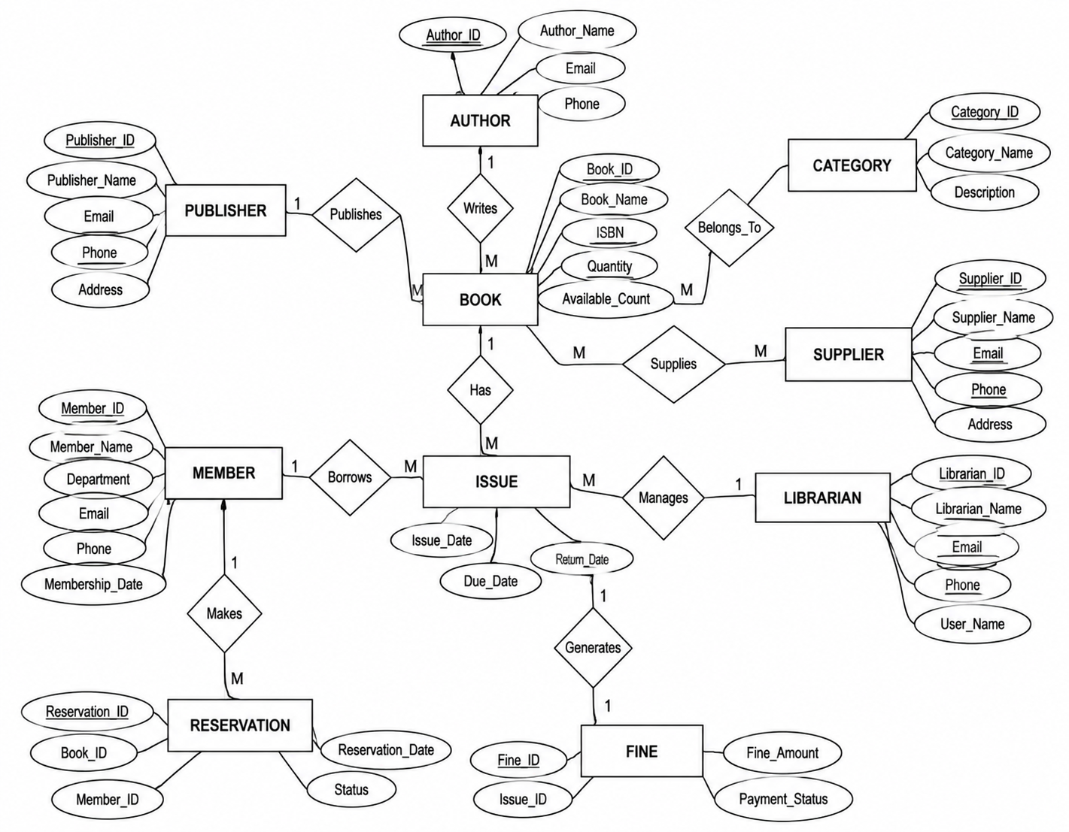
4. ER DIAGRAM

Slide 6
5. Database Schema Used for Implementation
Table | Primary Key | Foreign Keys
AUTHOR | Author_ID | —
PUBLISHER | Publisher_ID | —
CATEGORY | Category_ID | —
SUPPLIER | Supplier_ID | —
BOOK | Book_ID | Author_ID, Publisher_ID, Category_ID
MEMBER | Member_ID | —
LIBRARIAN | Librarian_ID | —
ISSUE | Issue_ID | Book_ID, Member_ID, Librarian_ID
FINE | Fine_ID | Issue_ID
RESERVATION | Reservation_ID | Book_ID, Member_ID

Slide 7
6. Table Design and Constraints
Table | Key / Validation Rules
AUTHOR | PK: Author_ID; Author_Name, Email, Phone
PUBLISHER | PK: Publisher_ID; Publisher_Name, Email, Phone, Address
CATEGORY | PK: Category_ID; Category_Name, Description
SUPPLIER | PK: Supplier_ID; Supplier_Name, Email, Phone, Address
BOOK | PK: Book_ID; FK: Author_ID, Publisher_ID, Category_ID; Book_Name, ISBN, Quantity, Available_Count

Slide 8
Table Design and Constraints
MEMBER | PK: Member_ID; Member_Name, Department, Email, Phone, Membership_Date
LIBRARIAN | PK: Librarian_ID; Librarian_Name, Email, Phone, Username
ISSUE | PK: Issue_ID; FK: Book_ID, Member_ID, Librarian_ID; Issue_Date, Due_Date, Return_Date
FINE | PK: Fine_ID; FK: Issue_ID; Fine_Amount, Payment_Status, Payment_Date
RESERVATION | PK: Reservation_ID; FK: Book_ID, Member_ID; Reservation_Date, Status

Slide 9
7. Normalization up to 3NF
UNF – Unnormalized Form
Library information may contain repeated details about books, authors, publishers, members, issues, and fines in a single record.
Repeated data can lead to data redundancy and inconsistency.
1NF – First Normal Form
Remove repeating groups.
Store each attribute as a single, atomic value.
Each record represents one specific entity/transaction.
2NF – Second Normal Form
Remove partial dependencies.
Separate information into related tables such as BOOK, MEMBER, AUTHOR, PUBLISHER, and ISSUE.
Non-key attributes depend on the complete primary key.
3NF – Third Normal Form
Remove transitive dependencies.
Store independent information in separate relations, such as CATEGORY, SUPPLIER, LIBRARIAN, and FINE.
Non-key attributes depend only on the primary key

Slide 10
8. SQL Implementation – DDL
DDL Operations Implemented
CREATE DATABASE – Creates the LibraryDB database.
USE – Selects the LibraryDB database.
CREATE TABLE – Creates the 10 library tables.
PRIMARY KEY – Defines unique identifiers for each table.
FOREIGN KEY – Establishes relationships between related tables.
NOT NULL – Defines mandatory attributes.
UNIQUE – Prevents duplicate values.
CHECK – Validates numeric values such as quantity and fine amount.
DEFAULT – Provides default values for selected attributes.
ALTER TABLE – Modifies the Book table structure.
DESC – Displays the structure of the Book table.
SHOW TABLES – Displays all tables in the database.

Slide 11
9. SQL Implementation – DML
DML Operations Implemented
INSERT – Insert sample records into all 10 project tables.
UPDATE – Modify existing records.
DELETE – Delete eligible records while maintaining referential dependencies.
Insert parent-table records before child-table records to satisfy foreign-key constraints.
Use realistic sample data for meaningful project queries.

Slide 12
10. DQL – Data Retrieval
DQL Operations Used
SELECT – Retrieve data from tables
WHERE – Filter records based on conditions
ORDER BY – Sort records in ascending/descending order
DISTINCT – Display unique values
LIKE – Search books using a pattern
IS NOT NULL – Retrieve records having available values
JOIN – Retrieve related information from multiple tables

Slide 13
11. SQL Queries – Joins
Joins Implemented
Book + Author
  Displays Book ID, Book Name and Author Name.
Book + Publisher
  Displays Book ID, Book Name and Publisher Name.
Book + Category
  Displays Book ID, Book Name and Category Name.
Issue + Book + Member
  Displays Book Name, Member Name, Issue Date and Due Date.
Issue + Fine
  Displays Issue ID, Book ID, Fine Amount and Payment Status

Slide 14
12. SQL Queries – Aggregate Functions
Aggregate Functions Used
COUNT() – Counts the total number of books.
AVG() – Calculates the average book quantity.
MAX() – Finds the maximum book quantity.
MIN() – Finds the minimum book quantity.
SUM() – Calculates the total quantity of books.
GROUP BY – Groups books based on Category ID.
HAVING – Filters grouped results based on a condition.

Slide 15
13. CRUD Operations
Operation | SQL Command | Purpose
C – Create | INSERT | Add a new book record
R – Read | SELECT | Retrieve book details
U – Update | UPDATE | Modify existing book information
D – Delete | DELETE | Remove a book record
CRUD Flow
CREATE → READ → UPDATE → DELETE

Slide 16
14. Views
View Used in Library Management System
View Name: Library_Book_View
The view is created to display frequently required information about books.
Information Included
Book ID
Book Name
ISBN
Quantity
Available Count

Slide 17
15. Data Integrity and Validation
Entity Integrity
  Primary keys uniquely identify each record.
  Example: Book_ID, Member_ID, Author_ID.
Referential Integrity
  Foreign keys maintain relationships between related tables.
  Example: Book.Author_ID references Author.Author_ID.
Uniqueness
  UNIQUE constraints prevent duplicate values.
  Applied to fields such as Email, ISBN and User_Name.
Mandatory Fields
  NOT NULL ensures important information is provided.
  Example: Book Name, Member Name and Issue details.
Domain Validation
  CHECK constraints restrict invalid values.
  Example: Quantity >= 0, Available_Count >= 0 and Fine_Amount >= 0.
Default Values
  DEFAULT automatically provides values when required.
  Example: Membership Date, Issue Date and Reservation Status.

Slide 18
16. SQL Output and Screenshots
DQL Execution
  Book retrieval and filtering
  Sorting and searching
  Issued book details
JOIN Queries
  Book–Author
  Book–Publisher
  Book–Category
  Issue–Member
  Issue–Fine
Aggregate Queries
  COUNT(), AVG(), MAX(), MIN(), SUM()
  GROUP BY and HAVING
CRUD Operations
  Create, Read, Update and Delete
View
  Library_Book_View output
Database and Table Creation
  LibraryDB database
  10 tables created successfully
DDL Execution
  Table structures
  Primary keys, foreign keys and constraints
DML Execution
  Inserted sample records
  Updated records
  Deleted reservation record

Slide 19
17. Query Coverage for Demonstration
SQL Concept | Queries Covered
Basic SELECT | 2+
Filtering – WHERE | 2+
Sorting – ORDER BY | 1
DISTINCT | 1
LIKE Search | 1
IS NOT NULL | 1
JOIN Queries | 5
Aggregate Functions | 5
GROUP BY | 1
HAVING | 1
CRUD Operations | 4
Views | 1
18

Slide 20
18. Live Database Demonstration – Recommended Order
1. Open Database
Select the LibraryDB database.
Show the list of tables using SHOW TABLES;.
2. Show Table Structure
Display the structure of important tables using DESC.
Explain primary keys, foreign keys and constraints.
3. Show Sample Data
Display the records inserted into the tables.
Explain the relationships between the tables.
4. Demonstrate DDL & DML
Show table creation and alteration.
Demonstrate INSERT, UPDATE and DELETE.
5. Demonstrate DQL
Execute SELECT, WHERE, ORDER BY, DISTINCT and LIKE queries.
6. Demonstrate JOIN Queries
Show how related information is retrieved from multiple tables.
7. Demonstrate Aggregate Functions
Execute COUNT(), AVG(), MAX(), MIN(), SUM(), GROUP BY and HAVING.
8. Demonstrate CRUD Operations
Show Create, Read, Update and Delete operations.
9. Demonstrate View
Display the Library_Book_View and retrieve its data.
10. Conclude
Explain how the implemented database supports the requirements of the Library Management System.

Slide 21
19. Conclusion
The Library Management System was successfully implemented using a relational database approach.
The database consists of 10 related tables representing books, authors, publishers, categories, suppliers, members, librarians, issues, fines and reservations.
Primary keys, foreign keys and integrity constraints are used to maintain accurate and consistent data.
SQL concepts including DDL, DML, DQL, JOINs, aggregate functions, CRUD operations and Views were implemented.
The database supports efficient data storage, retrieval and management of library information.
The implementation provides a strong database foundation for further development of the Library Management System.

Slide 22
20. Future Enhancements
Enhancement | Description
Online Book Reservation | Allow members to reserve books through an online interface.
Automated Notifications | Send reminders for due dates, overdue books and reservations.
Fine and Payment Management | Improve tracking of fines and payment status.
Reports and Analytics | Generate reports for books, members, issues, fines and reservations.
User Authentication | Provide role-based access for librarians, members and administrators.
Backup and Security | Improve database backup, recovery and security mechanisms.
Web/Mobile Application | Integrate the database with a user-friendly web or mobile application.

Slide 23
21. References
Korth, H. F., Silberschatz, A., and Sudarshan, S., Database System Concepts, McGraw Hill.
Elmasri, R. and Navathe, S. B., Fundamentals of Database Systems, Pearson.
MySQL 8.0 Reference Manual, Oracle Corporation.
Draw.io, Online Diagramming ,Schema Diagram and ER Diagram Design Tool, diagrams.net.

Slide 24
22. Final Review Checklist
Review Area | What students must demonstrate
Database Design | Title, problem statement, objectives, ER diagram, relational schema
Implementation | LibraryDB database and all 10 project tables created
Constraints | PK, FK, NOT NULL, UNIQUE, CHECK, DEFAULT
Sample Data | All tables populated with sample records
SQL | DDL, DML and DQL demonstrated
CRUD | Create, Read, Update and Delete demonstrated
Queries | Joins, aggregate functions, GROUP BY / HAVING, View
Normalization | UNF → 1NF → 2NF → 3NF explained
Integrity | Primary key, foreign key, uniqueness and valid-value constraints demonstrated
Documentation | ER diagram, schema, SQL, outputs and screenshots
Presentation | Working Library Management System demonstrated live

